Slide 1
Personal Bank Loan Analysis
-- DATA ANALYSIS REPORT OF CONVERTING BANK DEPOSITORS
TO PERSONAL LOAN CUSTOMERS
Presented by：Vivian Kuang
Date: August 22nd, 2023

Slide 2
Agenda
01
Motivation
CONTENT
PART ONE
02
Data Analytics
PART TWO
03
Machine Learning Models
PART THREE
04
Conclusion
PART FOUR

Slide 3
PART ONE
Motivaton
Business Problem Introduction and Objectives

Slide 4
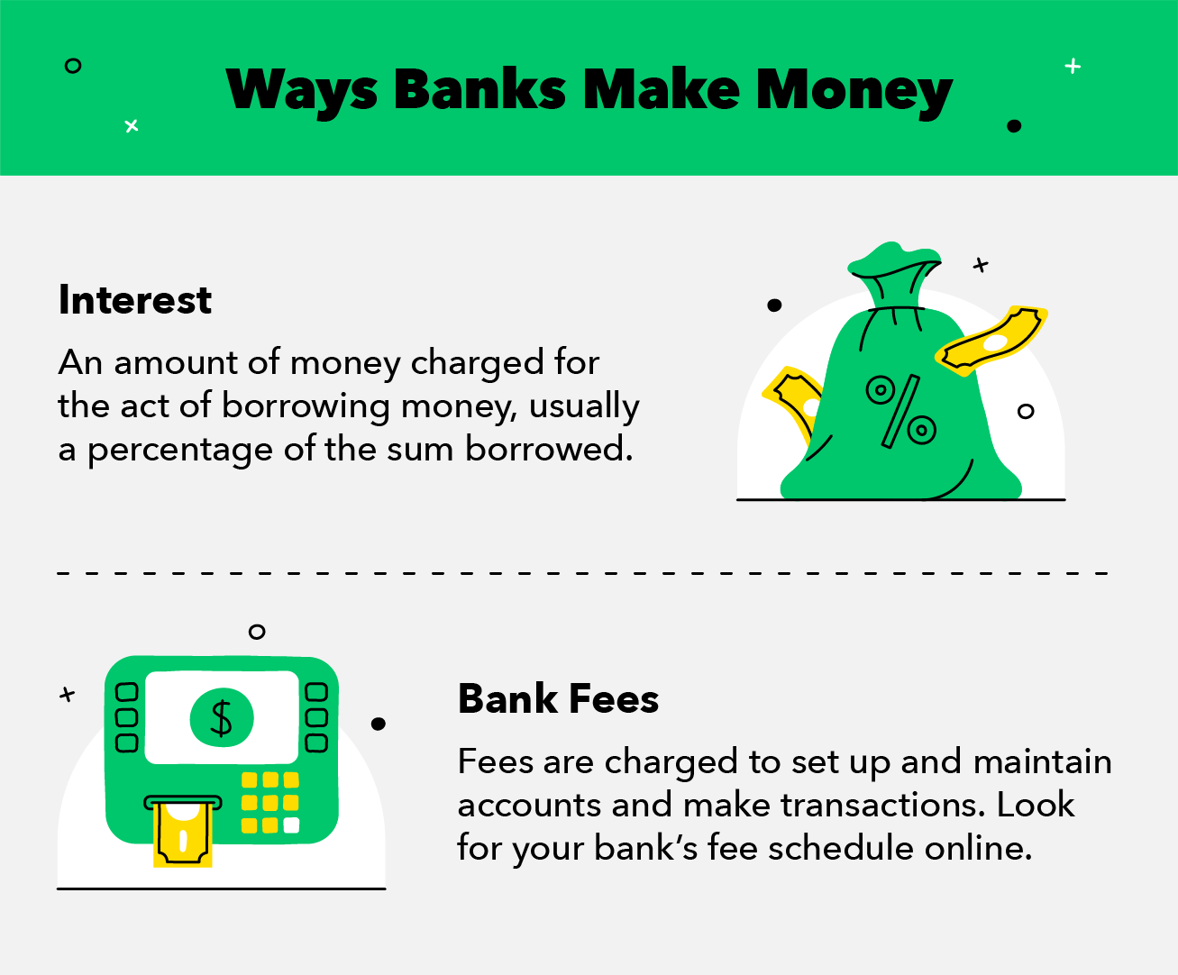
How Banks Improve the Profits

Slide 5
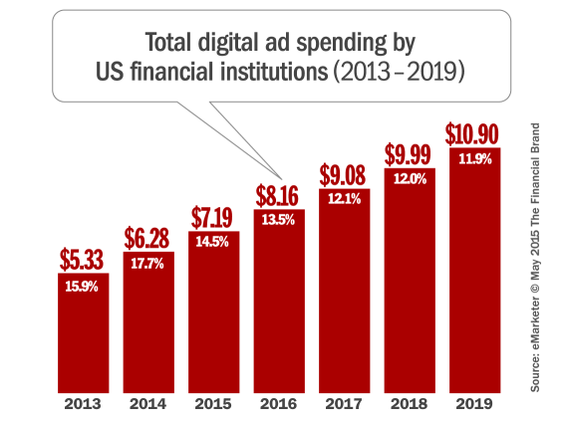
Market Budgets Trend
US financial institutions’s market budgets increase much every year
Business Objectives
1, Increse the profit
2, Cut the budget
3, Improve Customer Satisfaction

Slide 6


Benefits of Converting
Create much profit: By converting the depositers to Personal Loan, banks earn interest from the customers
。
Save market budget: locating the potential customers’ needs and converting to Personal Loan Customers
Activate the customers: Inactive customers consume resource and create little revenue to the banks

Slide 7
PART TWO
Data Analytics and Results

Slide 8
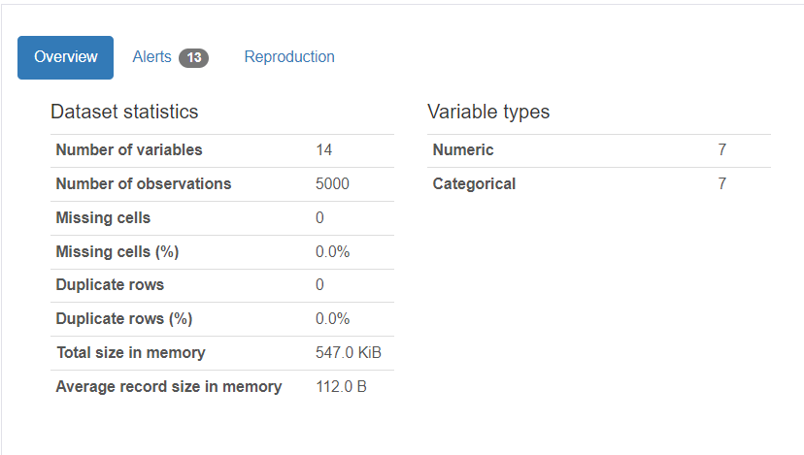
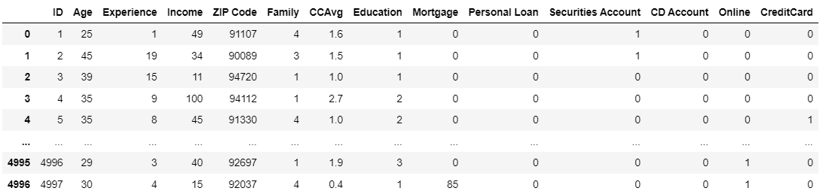

Data Overview
The Backgound of Thera-Bank Dataset:
The management the Thera Bank wants to look for ways to convert its liability customers into retail loan customers while keeping them as depositors. The bank ran a campaign last year for deposit customers showed a conversion rate of over 9.6% success.

Slide 9
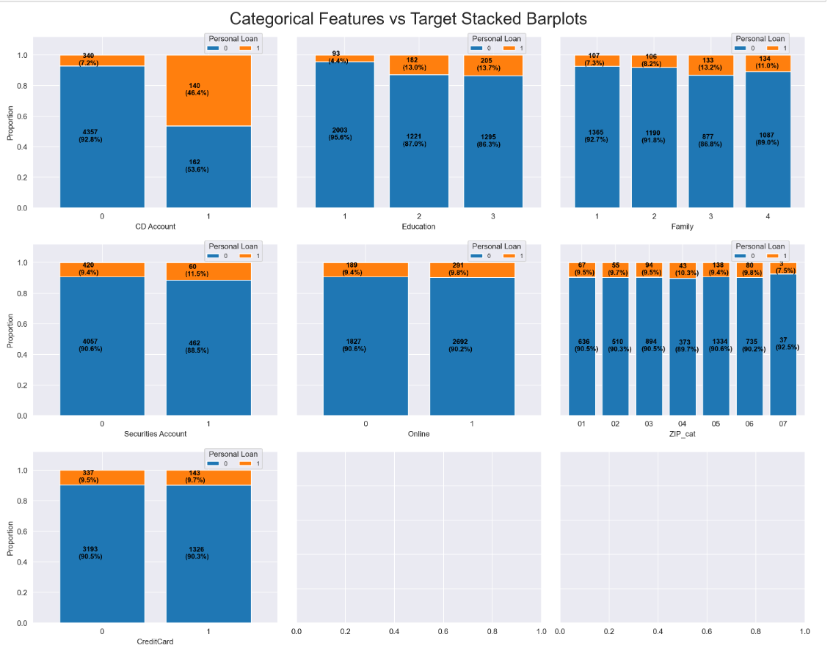
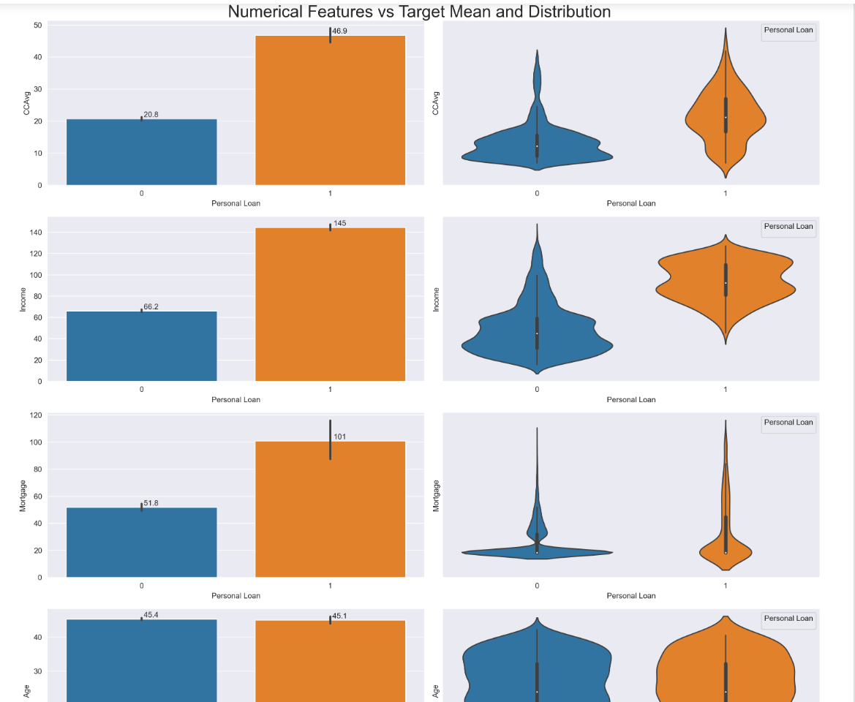
Categorical and Numeric Features Analysis

Slide 10
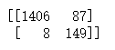
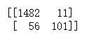
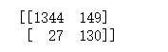
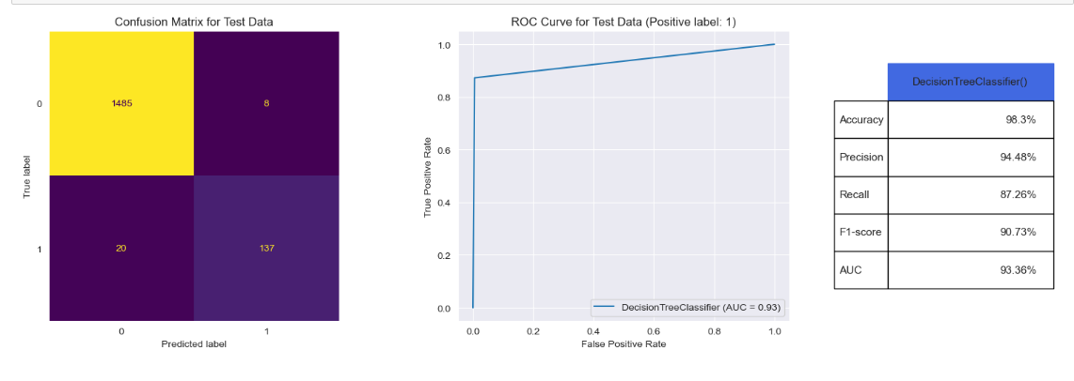
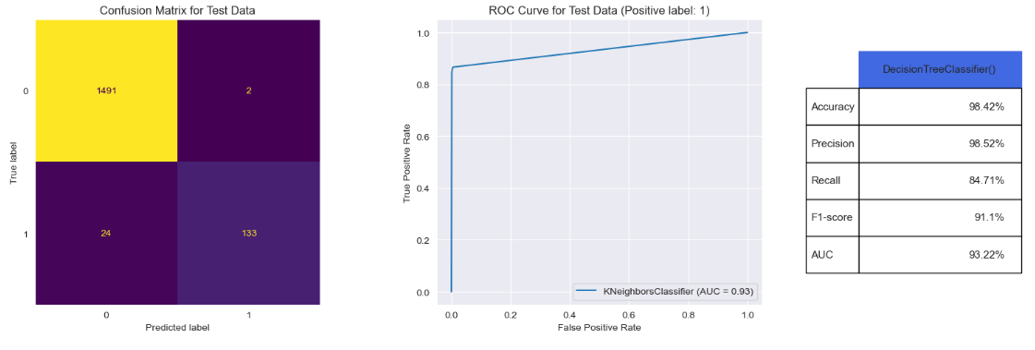
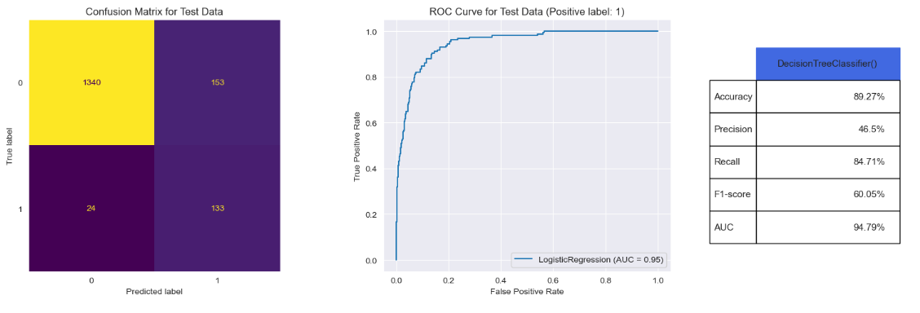
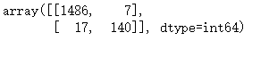
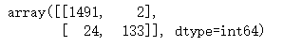
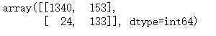
Results Reports - ML Classifiers
Decison Tree
KNN
Logistic Reg
98.3%
96.4%
89.3%

Slide 11
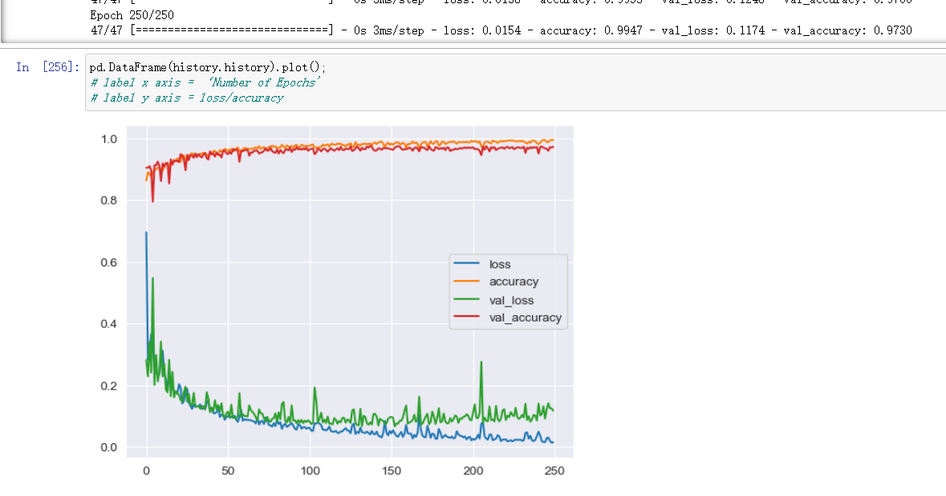
Results Reports - Deep Learning NN - Tensorflow
97.3%
NN Sequential

Slide 12
PART THREE
Building ML Models
PROVIDE REFERENCE FOR DECISION MAKING

Slide 13
Solving the problem with ML
Step 1: EDA
EDA to study and visualize the dataset and features
Step 5: Tuning Models
Tuning and evaluating the results of the algorithms
Step 2: Data Cleansing
Remove Noise
Duplicate rows
Imputaton, Outliers
Step 4: Choosing Algorithm
Classification Algorithms: DT
KNN, Logistic Regression, NN
Step 3: Feature Engineering
New Features
Feature Selection
Feature Transform

Slide 14
PART FOUR
Conclusion and Next Step

Slide 15
Conclusions and Next Steps
The results was not improved significantly with proper feature selection in this dataset
Tunning the parameters helps use the best of the algorithms
01
Decision Tree with tuned parameters and feture selection provide “better results”
Algorithm Evaluation
Optimized
ML Models
02
Netural Network could be tunned for better results
Feature Engineering
03
Other Algorithms, SVC, XGBoost for Classification
Parameter Tuning

Slide 16
THANK YOU & QUESTIONS
THANKS FOR ALL
Vivian Kuang
August 22nd, 2023

